Slide 1
Housekeeping Scheduling System
RLL Project
Group-5

Slide 2
Team Lead: Pradyumna Rajendra Mangave
Team Members:
Pathakota Hari Chandana
Patan Munna Galib Khan
Pallvi Dadabhau Dandawate
Peddimsetti Vamsi
Pankaj Gajanan Kavane
Pittam Ramireddy
Prachi Gururani
Prajakta Hajare
Priya Jain
(Back End Team Lead)
(Front End Team Lead)

Slide 3
Front End Team
Back End Team
Patan Munna Galib Khan
Pallvi Dadabhau Dandawate
Pankaj Gajanan Kavane
Prachi Gururani
Prajakta Hajare
Pathakota Hari Chandana
Peddimsetti Vamsi
Pradyumna Rajendra Mangave
Pittam Ramireddy
Priya Jain

Slide 4
Contents:
Objective
Architecture
Class Diagram
Tools And Technologies
Modules
ER diagram
Advantages
Disadvantages
Screenshots
Conclusion

Slide 5
Objective:
The main objective of HOUSEKEEPER SHEDULING SYSTEM is hostel students can use to get their rooms cleaned on time.
Admin will select a housekeeper and allots a housekeeper with a specific request coming from a student
By using HOUSEKEEPER SHEDULING SYSTEM we can maintain the feedback and request status of the user.

Slide 6
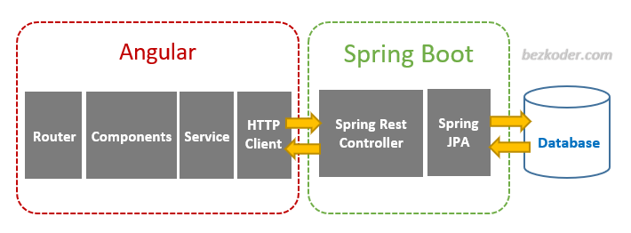
Architecture:

Slide 7
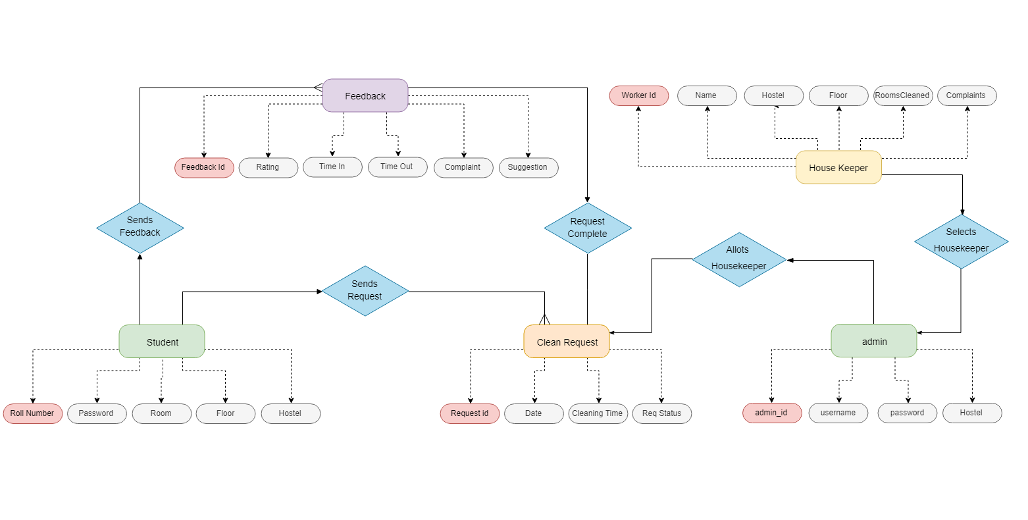
Class Diagram :

Slide 8
Tools And Technologies Used :
Front End – Angular
Back End – MySql
Server Side – Spring Boot
Web Server - Tomcat

Slide 9
HTML+CSS :
HTML stands for Hyper Text Markup Language
HTML describes the structure of a Web page
HTML consists of a series of elements
HTML elements tell the browser how to display the content
CSS stands for Cascading Style Sheets
CSS describes how HTML elements are to be displayed on screen, paper, or in other media
CSS saves a lot of work. It can control the layout of multiple web pages all at once

Slide 10
Angular:
Angular is primary written in TypeScript. It implements core and optional functionality as a set of TypeScript libraries that you import into your applications.
The architecture of an Angular application relies on certain fundamental concepts. The basic building blocks of the Angular framework are Angular components that are organized into NgModules.
Angular is a platform and framework for building single-page client (SPA) applications using HTML and TypeScript.
Angular helps develop desktop applications for different operating systems.

Slide 11
MySQL:
MySQL is a fast, easy-to-use RDBMS being used for many small and big businesses.
MySQL uses a standard form of the well-known SQL data language.
MySQL works very quickly and works well even with large data sets.
It is open-source database software, which is supported by Oracle Corporation.
MySQL follows the working of Client-Server Architecture.

Slide 12
Spring Boot:
Spring Boot makes it easy to create stand-alone, production-grade Spring based Applications that you can "just run".
Spring Boot is an open source Java-based framework used to create a micro Service.
It provides a flexible way to configure Java Beans, XML configurations, and Database Transactions.
In Spring Boot, everything is auto configured; no manual configurations are needed.

Slide 13
Modules :
There are 2 modules in this project
Admin Module
User Module
Admin Module:
Login: Admin can login his personal account.
Dashboard: Where all the details are displayed.
Allot: Admin can allot a housekeeper.
Complaints: Complaints which are raised by the user are displayed.
Suggestions: Suggestions which are given by the user are displayed.
Register Student: Admin can register a new student.
Register Housekeeper: Admin can register a new housekeeper.
Logout: Admin can logout after the completion of his work

Slide 14
2. User Module:
Login: User can login his personal account.
Dashboard: Where all the details are displayed.
Requests: User can request a housekeeper by selecting date and time.
Feedback: User gives the feedback like suggestions and complaints about the housekeeper performance.
Profile: Details of the User.
Logout: User can logout after the completion of his work.

Slide 15
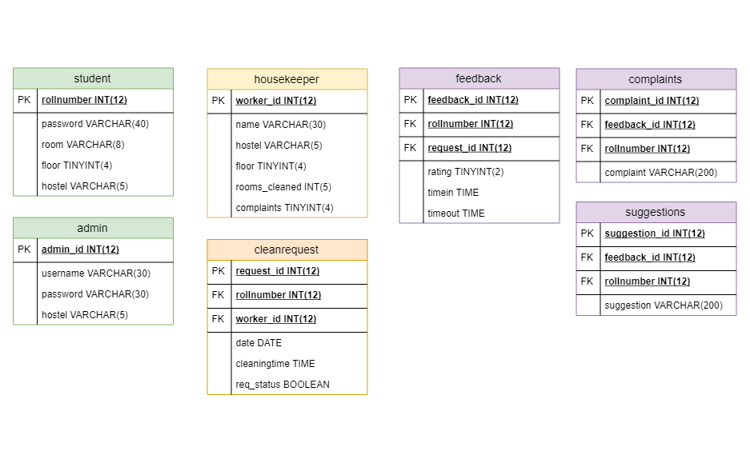
ER Diagram :

Slide 16
Advantages :
This application is user friendly and easy to use.
Admin means warden can see feedback and complaints of students for housekeeper and can take action on them.
Student can connect to this system any time.
Admin will get digital record of who cleaned which room at which time.

Slide 17
Disadvantages :
Not 100% secure
Technical glitches can come

Slide 18
Screenshots:

Slide 19
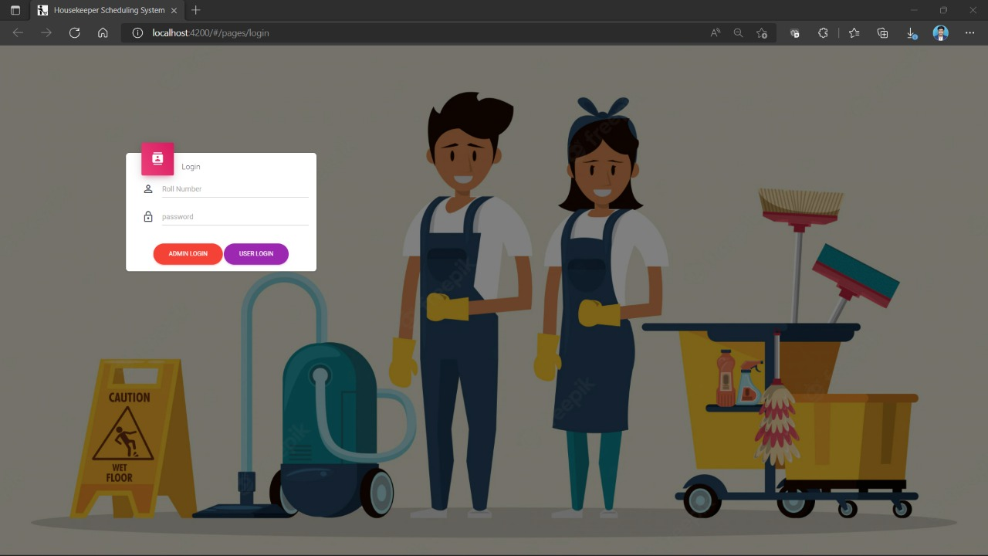

Slide 20
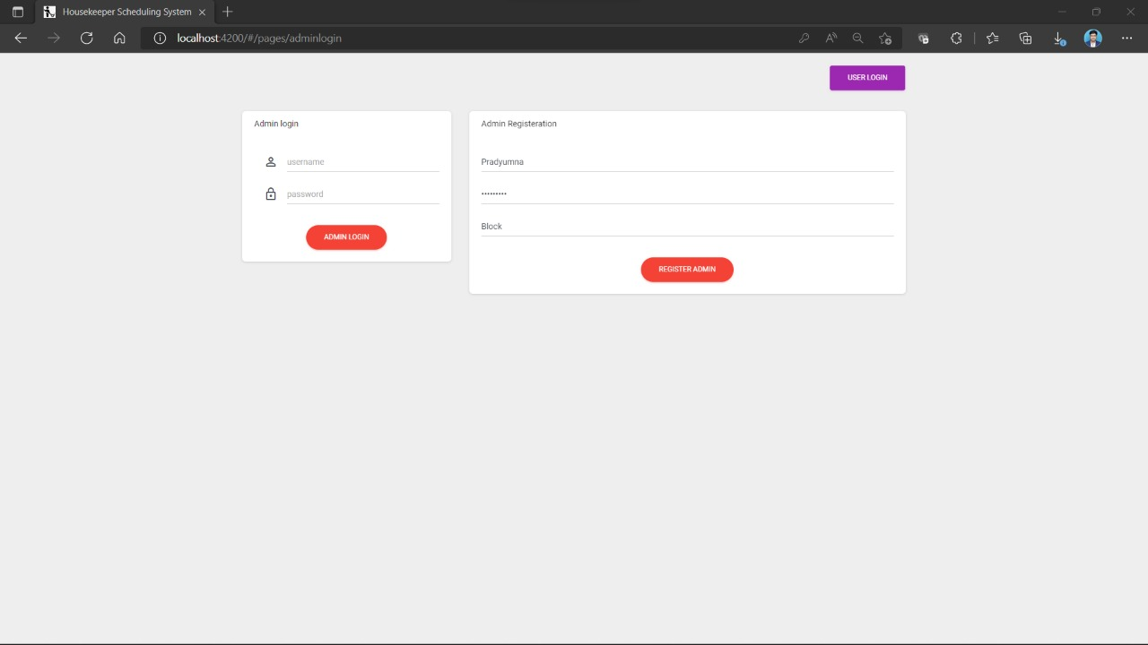

Slide 21


Slide 22
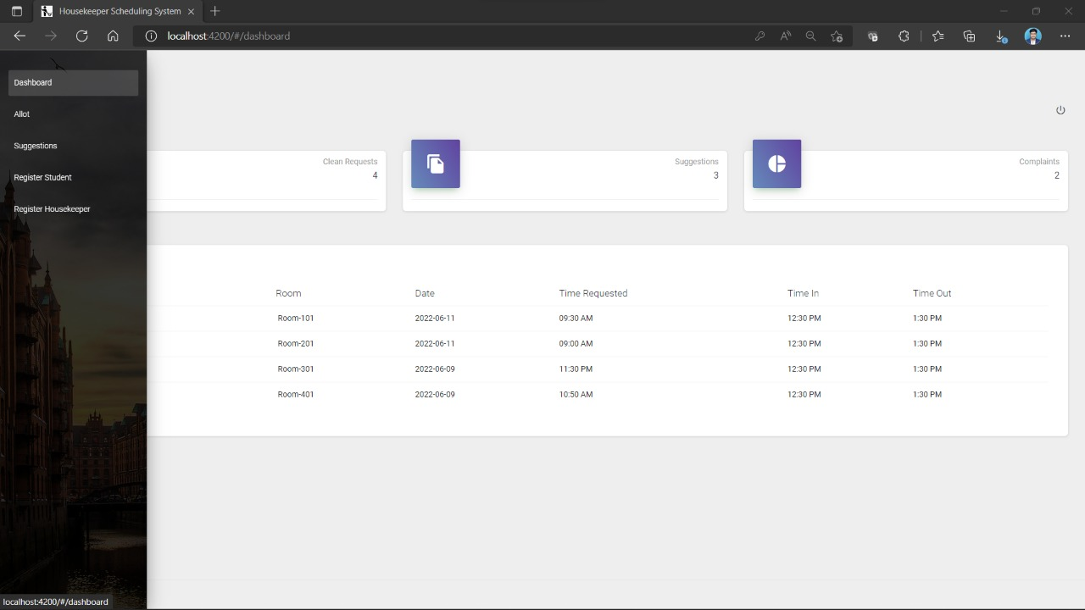

Slide 23
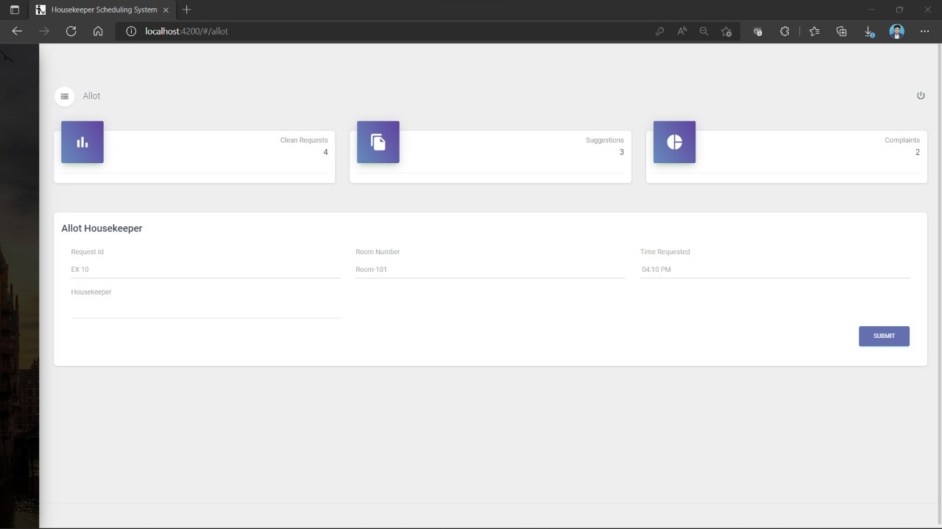

Slide 24
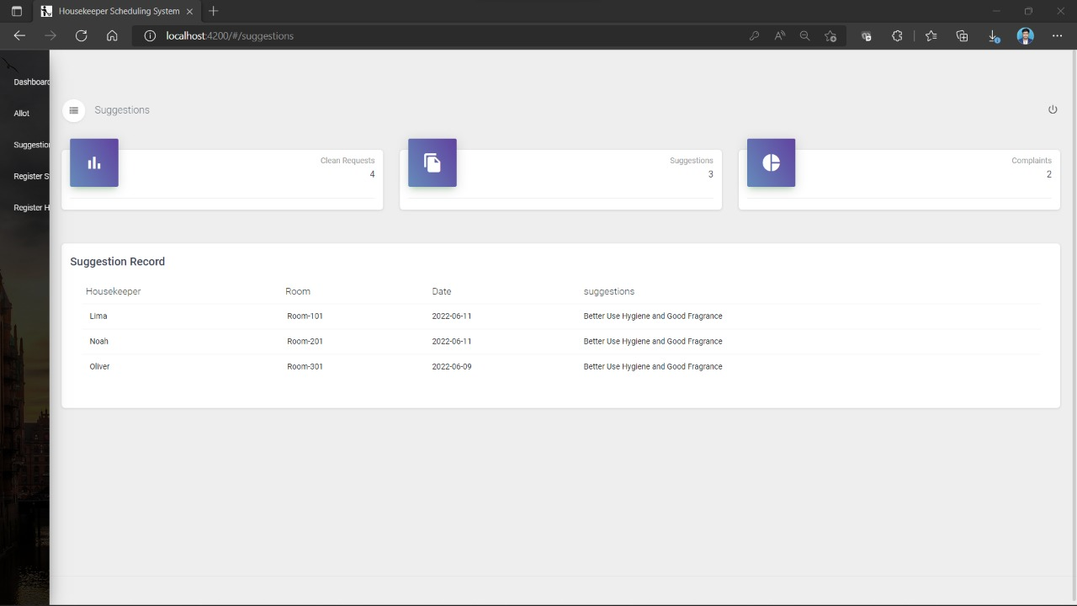

Slide 25
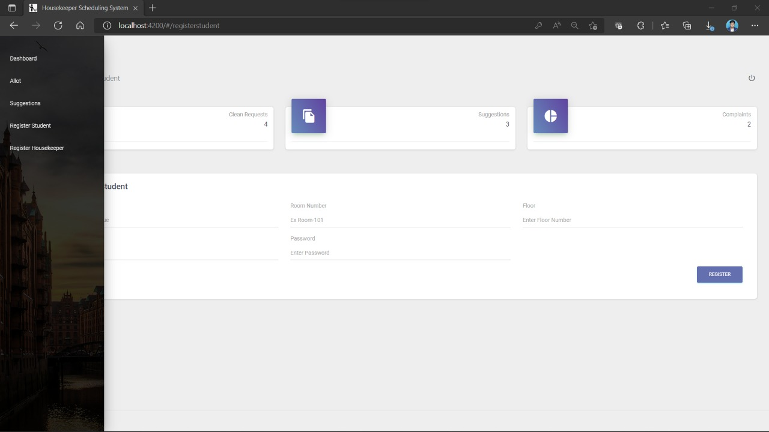

Slide 26
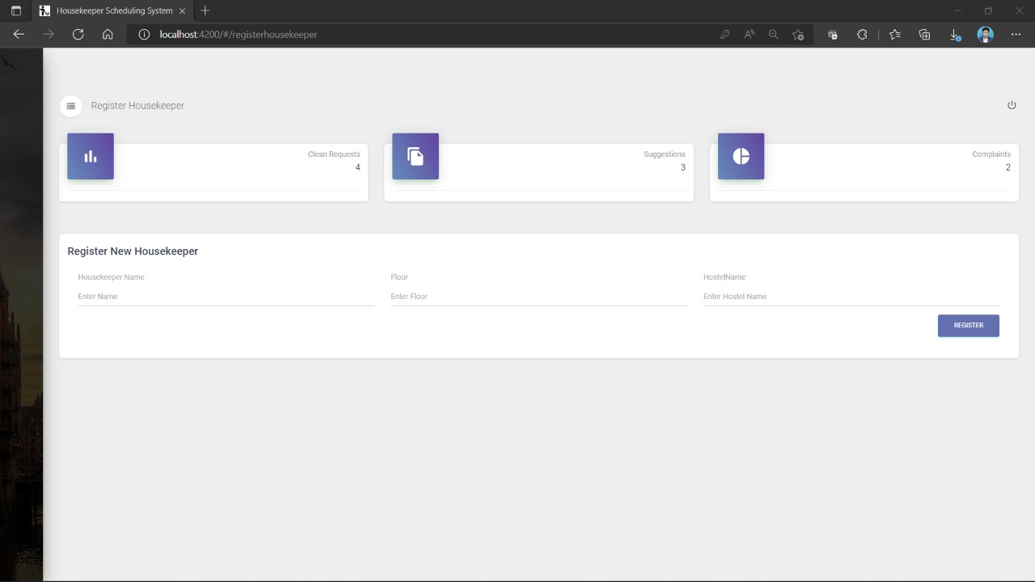

Slide 27
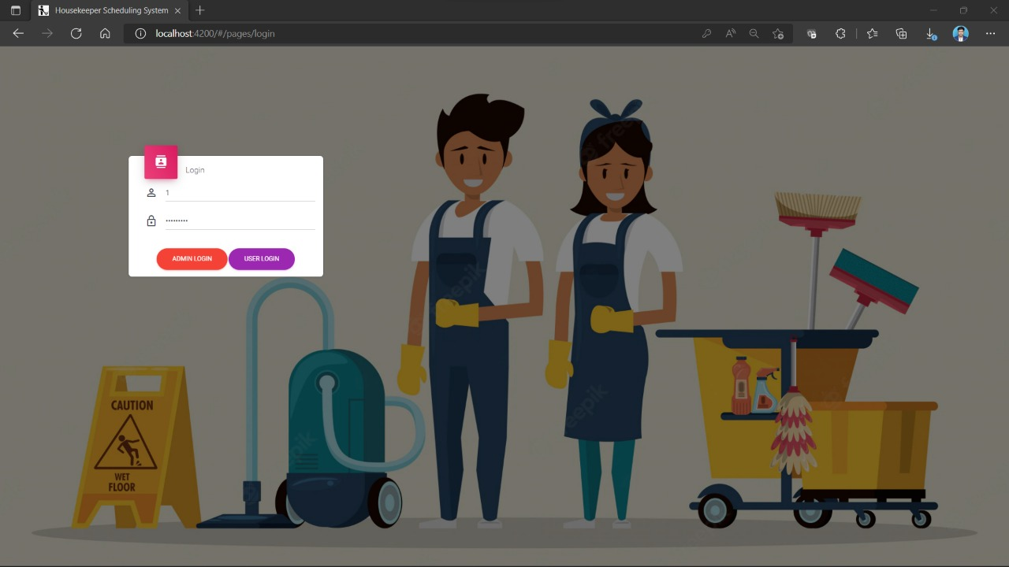

Slide 28
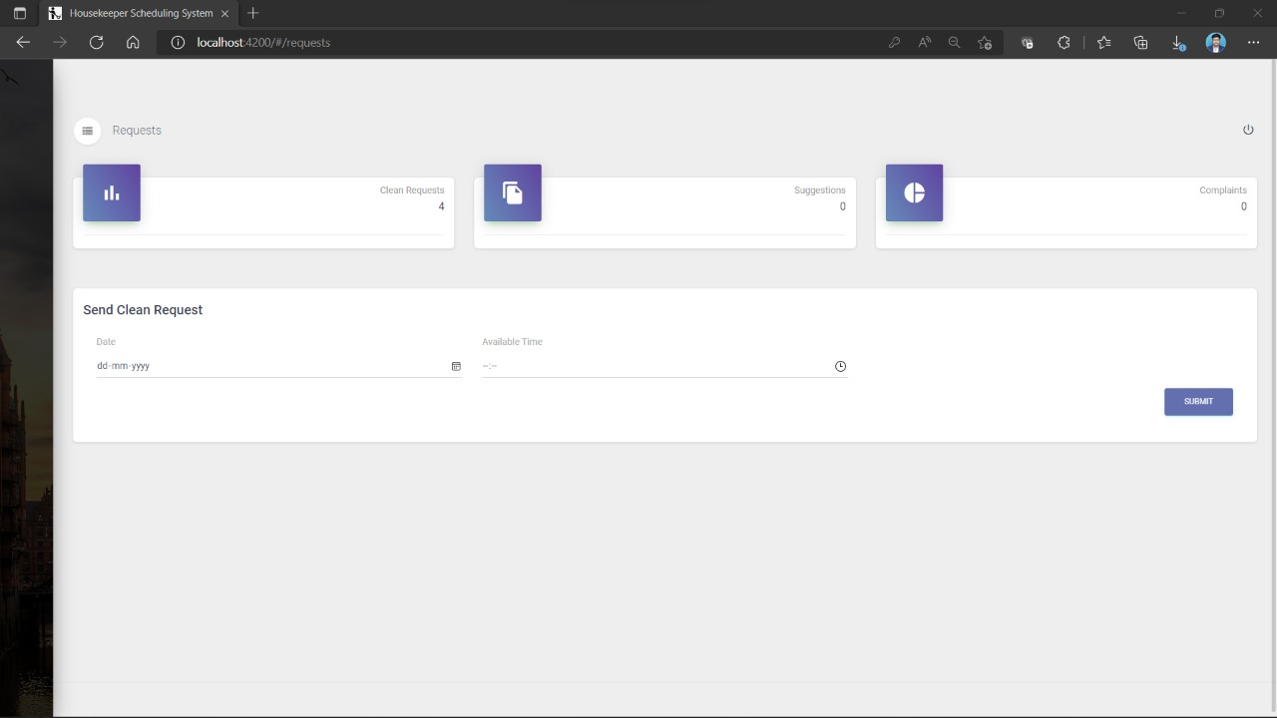

Slide 29
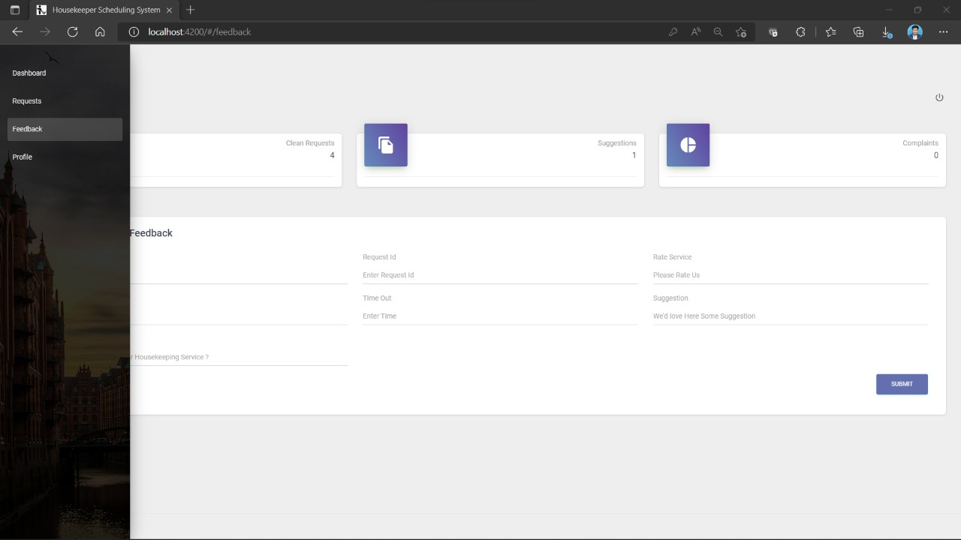

Slide 30
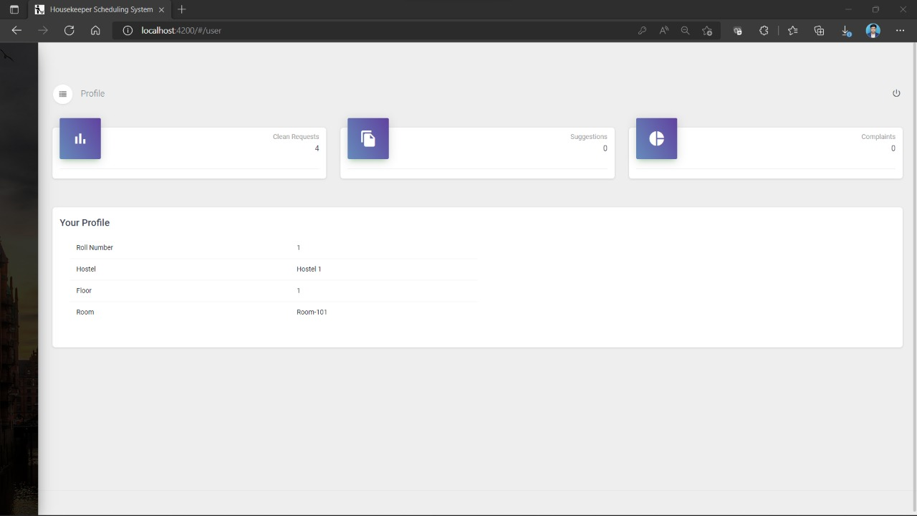

Slide 31
Conclusion :
The Housekeeper Scheduling System Application Student send clean request to admin in admin side automatically create a cleaning schedule.
This system develops a new trends serves to meet user expectations, enhance service delivery and improve efficiency .

Slide 32


